Slide 1
STOR 455 METHODS OF DATA ANALYSIS INTRODUCTION TO R & REVIEW OF INFERENCE
Kai Zhang
zhangk@email.unc.edu

Slide 2
Data
Data are numbers with a context.
Departures from a Pattern
Data
=
Pattern
+
How do we identify the actual pattern?
How do we characterize the departures (errors)?

Slide 3
Statistical Modeling
Find a model for a relationship between a response variable (Y) and one (or more) predictor/explanatory variables (X₁, X₂, ..., X_{k}).

Slide 4
Purposes for Statistical Modeling
1. Making predictions
2. Understanding relationships
3. Assessing differences

Slide 5
Types of Variables
Quantitative: expressible as numbers for which arithmetic makes sense
Categorical: divides sample points into groups
Binary = categorical with just two groups

Slide 6
Two Main Themes of STOR 455
Types of Response
Quantitative
Categorical
Types of Predictors
Quantitative
Categorical
(1)
(2) Allow for models with multiple predictors.

Slide 7
Outline of Stat2 Text
Chapter | Response | Predictor/Explanatory
1&2 | Quant. | Single Quantitative
3&4 | Quant. | Multiple Quantitative
5 | Quant. | Single Categorical
6&7 | Quant. | Multiple Categorical
9 | Cat. | Single Quant./Cat.
10&11 | Cat. | Multiple Quant./Cat.

Slide 8
Building a Statistical Model: Four Step Process
1. CHOOSE – Pick a form for the model
2. FIT – Estimate any parameters
3. ASSESS – Is the model adequate? Could it be simpler? Are conditions met?
4. USE – Answer the question of interest

Slide 9
General form of a model:
Random Error
“Expected” Y for some combination of predictors
=
+
Data
Model
Error

Slide 10
Example: Lego Prices
Question:
How can we predict the price of a Lego set?
Data: Attributes of Lego sets, including their current sale price on Amazon
Predictor variables: Start with none.

Slide 11

Example: Constant Model
where c is an (unknown) constant
Terminology:
The constant c is a parameter of this model.
We use data to provide a sample estimate of c.
How should we estimate $c$ from data?

Slide 12




Predicted Value for Response
Get an estimate for Y using the predictors and the model with estimated parameters.
Notation: The predicted y is denoted $\hat{y}$
For the constant model: $\hat{y}=\hat{c}$
Examples:
$\hat{y}=\hat{c}=\overline{y}$ (sample mean)
$\hat{y}=\hat{c}=m$ (sample median)

Slide 13
Questions
(1) Which estimator (mean or median) is better?
i.e. How can we compare models?
(2) Is either model any good?
i.e. How can we asses fit?

Slide 14
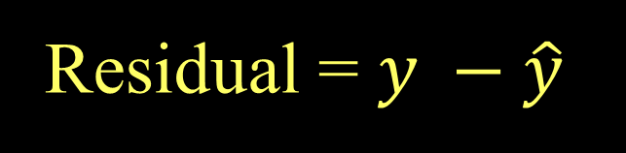
Residuals
Using the predicted value for each sample case the residual is
Residual = $y −\hat{y}$
Predicted
Actual

Slide 15



Criteria to Minimize Residuals?
Sum of residuals: $\sum{(y−\hat{y})}$
Sum of absolute deviations: $\sum{\left|y−\hat{y}\right|}$
Sum of squared errors: $\sum{{(y−\hat{y})}^{2}}$

Slide 16
Technology
We need software to automate computations…
R – a free, widely used, open source statistics package
Rstudio – an interface for R

Slide 17
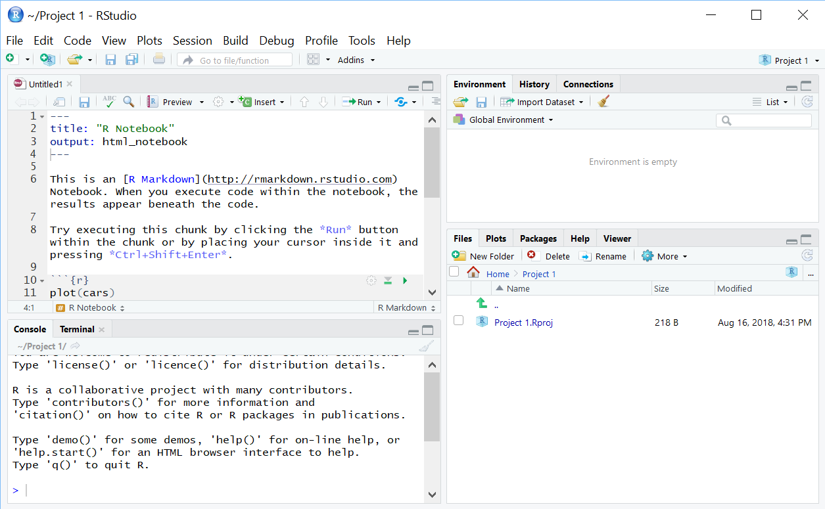
RStudio
Environment: lists active variables, functions, …
Editor: write/view code, data
Access files
View plots
Control packages
View help
Console: Enter commands, view output, error messages

Slide 18
A First RStudio Session
Load the Lego data into R
Summarize the Amazon_Price variable
Numerical: mean and median
Graphical: histogram, boxplot
Compute and evaluate residuals

Slide 19
A First RStudio Session
Load the lego data into R
```{r}
# loads a package needed to use the read_csv() function
# install package before first using it for the first time
library(readr)
# loads the lego dataframe into the environment from GitHub
lego <- read_csv("https://raw.githubusercontent.com/JA-McLean/STOR455/master/data/lego.csv")
# Alternative way to load dataframe (remove # to use)
# lego.csv must be saved in the same folder as this notebook!
#lego <- read_csv(“lego.csv")
# Shows the variables and first 6 cases (by default)
head(lego)
```

Slide 20
A First RStudio Session
Summarize the Amazon_Price variable - Numerical: mean and median
# dataframe$variable_name
mean(lego$Amazon_Price, na.rm = TRUE)
median(lego$Amazon_Price, na.rm = TRUE)
[1] 57.8232
[1] 37.325

Slide 21
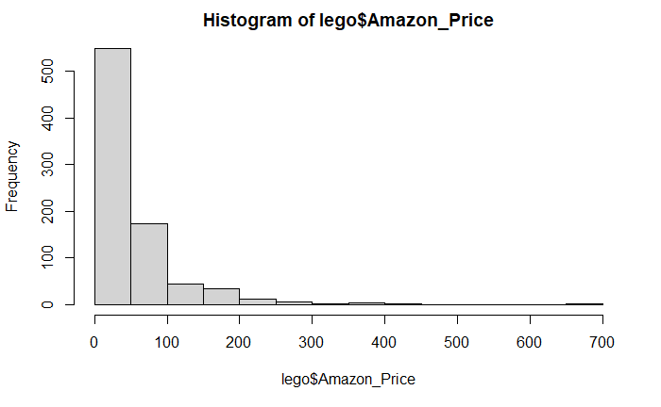
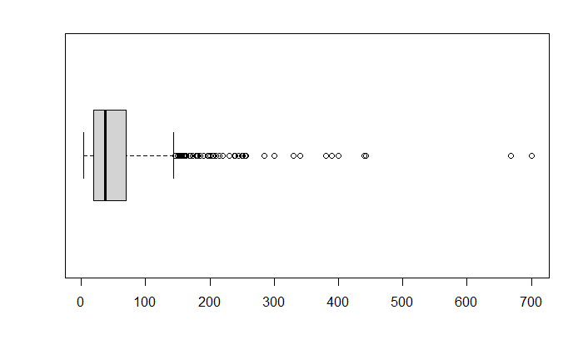
A First RStudio Session
Summarize the Amazon_Price variable - Graphical: histogram, boxplot
hist(lego$Amazon_Price)
boxplot(lego$Amazon_Price, horizontal = TRUE)

Slide 22
A First RStudio Session
Compute and evaluate residuals
# removes NA Amazon_Prices
lego_rm_AP_na = subset(lego, is.na(Amazon_Price) == FALSE)
# Assignment operators in R: = vs. <-
xbar = mean(lego_rm_AP_na$Amazon_Price)
m = median(lego_rm_AP_na$Amazon_Price)
residxbar = lego_rm_AP_na$Amazon_Price - xbar
residm = lego_rm_AP_na$Amazon_Price – m
sum(residxbar^2)
sum(residm^2)

Slide 23
Can we use a predictor to improve the model?
X = Number of Pieces in the Lego set?
See Chapter 1
X = Theme of the Lego set?
Two-sample t-test for a difference in means
(comparing only two themes)

Slide 24
Mosaic Package
install.packages("mosaic")
library(mosaic)
General use of “formulas”
Uses data= to minimize need for dataframe$variable
Example:
mean(Amazon_Price~Theme, data=lego_rm_AP_na)
Response ~ explanatory
(formula)

Slide 25
Amazon_Price vs. Theme
#These use the mosaic package
mean(Amazon_Price~Theme, data=lego_rm_AP_na)
tally(~Theme, data=lego_rm_AP_na)
sd(Amazon_Price~Theme, data=lego_rm_AP_na)
boxplot(Amazon_Price~Theme, data=lego_rm_AP_na, horizontal=TRUE)
Does Theme appear to be helpful for predicting Amazon_Price?

Slide 26
Amazon_Price vs. Theme
#These use the mosaic package
mean(Amazon_Price~Theme, data=lego_rm_AP_na)
tally(~Theme, data=lego_rm_AP_na)
sd(Amazon_Price~Theme, data=lego_rm_AP_na)
boxplot(Amazon_Price~Theme, data=lego_rm_AP_na, horizontal=TRUE)
Does Theme appear to be helpful for predicting Amazon_Price?
Let’s compare just two themes
lego_two_themes = subset(lego_rm_AP_na, Theme == 'Friends' | Theme =='Marvel')

Slide 27

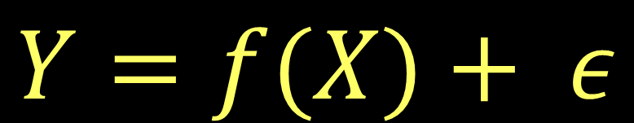
Model with a Binary Predictor
$$Y=f(X)+ ε$$
where X = Theme
μ₁ = mean Amazon_Price for Friends
μ₂ = mean Amazon_Price for Marvel
$$f\left(X\right)= \left\{\begin{matrix}μ_{1} if X=Friends \\ μ_{2} if X=Marvel \end{matrix}\right.$$

Slide 28
Two-sample T-Test Difference in Means
H_{o}: μ₁ = μ₂
H_{a}: μ₁ ≠ μ₂
Compare to a
t-distribution
t.test(Amazon_Price~Theme, data=lego_two_themes)
Welch Two Sample t-test
data: Amazon_Price by Theme
t = -1.1849, df = 69.32, p-value = 0.2401
alternative hypothesis: true difference in means between group Friends and group Marvel is not equal to 0
95 percent confidence interval:
-25.313078 6.446922
sample estimates:
mean in group Friends mean in group Marvel
42.26448 51.69756
What does this mean?

Slide 29
P-Value
The p-value is the proportion of samples, when the H₀ is true, that would be as (or more) extreme as the observed sample.
Decision: Reject H₀ only when the p-value is small.

Slide 30
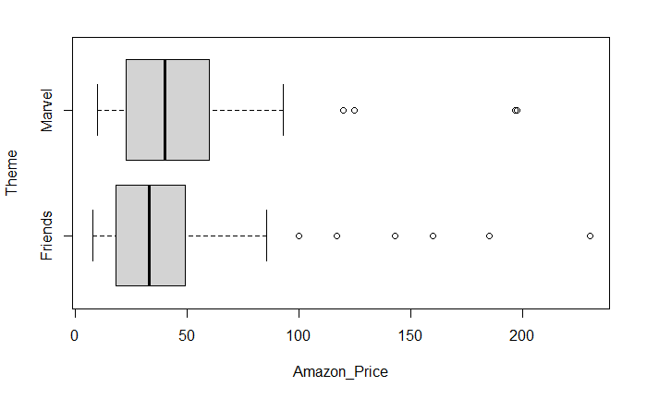
Normality?
The two-sample t-test assumes both samples are from normal populations
Does normality look reasonable?

Slide 31
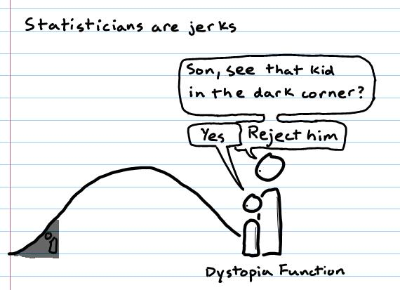
Review of Inferential Reasoning

Slide 32
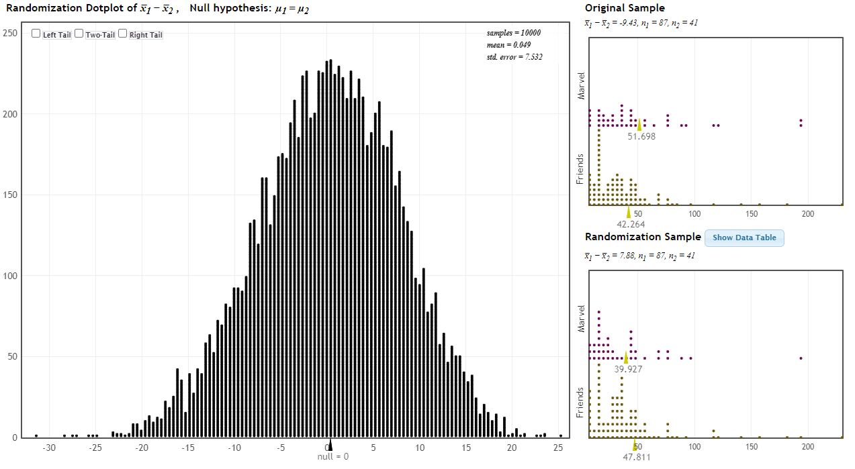
Inference Review: Hypothesis Testing
Is there a difference in the mean prices for all Friends vs Marvel Lego sets?
H_{o}: μ_{F} = μ_{M}
H_{a}: μ_{F} ≠ μ_{M}

Slide 33
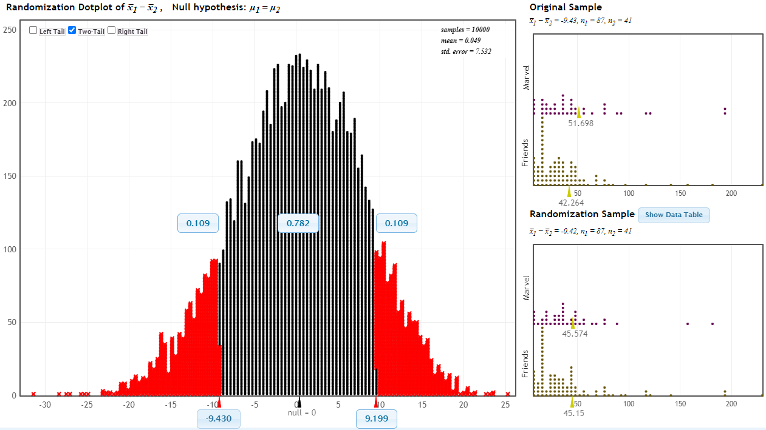
Inference Review: Hypothesis Testing
Is there a difference in the mean prices for all Friends vs Marvel Lego sets?
H_{o}: μ_{F} = μ_{M}
H_{a}: μ_{F} ≠ μ_{M}
There is a 21.8% chance that we would receive a samples with a difference as extreme as we did if the null hypothesis is true.
p-value = 0.218

Slide 34
Inference Review: Hypothesis Testing
Is there a difference in the mean prices for all Friends vs Marvel Lego sets?
H_{o}: μ_{F} = μ_{M}
H_{a}: μ_{F} ≠ μ_{M}
Since the p-value is greater than 0.05, we fail to reject the null hypothesis.
There is not evidence to suggest that there is a difference in the mean Amazon prices for Friends versus Marvel Lego sets
There is a 21.8% chance that we would receive a samples with a difference as extreme as we did if the null hypothesis is true.
p-value = 0.218

Slide 35
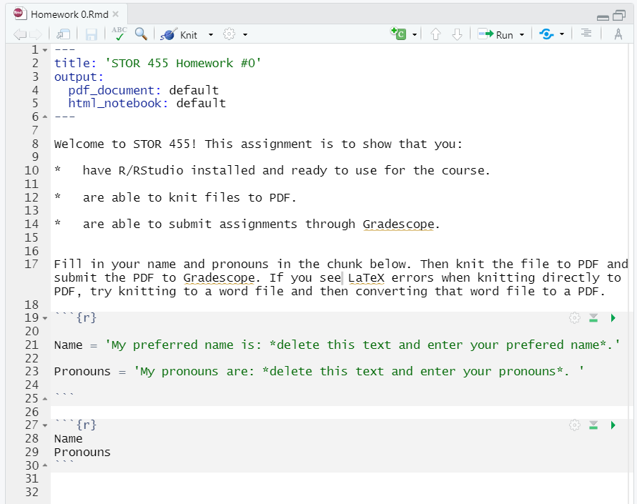
Homework 0

Slide 36
To Get A Stat2 Dataset
All of the datasets for the Stat2 textbook are stored in an R package called Stat2Data.
You need to load the Stat2Data package
To load an existing dataset, just call it with data( ).
data(BaseballTimes)
To see what's in the dataframe, use View( ) to put in the viewer or head( ) to show the first few cases
head(BaseballTimes)

